Slide 1


Our mission is to provide the highest quality
workforce development services available to our customers.
An Equal Opportunity Employer/Program. Auxiliary aids and services available upon request to individuals with disabilities.

Slide 2
Welcome to the SC Works Orientation. Effective August of 2011, the SC Department of Employment and Workforce launched “SC Works” as the new brand of the OneStop System. The brand places emphasis on the purpose of the system….Bringing employers and job seekers together! We are the connector.

Slide 3
OBJECTIVES
What is SC Works
Services Available
What is WIOA
Next Steps
Our objectives today are to provide you with an overview of the SC Works System, make you aware of the services we can provide to you, and get you thinking about your next steps towards finding employment.

Slide 4







What is SC Works?
SC Works is a system of partner agencies with the shared mission of assisting job seekers in obtaining self-sufficient employment in Berkeley, Charleston, and Dorchester Counties.
SC Works Partners include: (Not an Exhausted List)
South Carolina Department of Employment and Workforce (SC DEW),
Adult Education
WIOA Program Services (Adult, Dislocated Workers and Youth)
Military Community Connects (MCC)

Slide 5
Partner List Continued:
South Carolina Vocational Rehabilitation (VR),
South Carolina Commission for the Blind
Department of Social Services (DSS)
Telamon
Trident Technical College
Palmetto Community Action Partnership (PCAP)
Palmetto Goodwill Senior Community Service Program (SCSEP)
All SC Works partners area available by referral to SC Works customers.

Slide 6
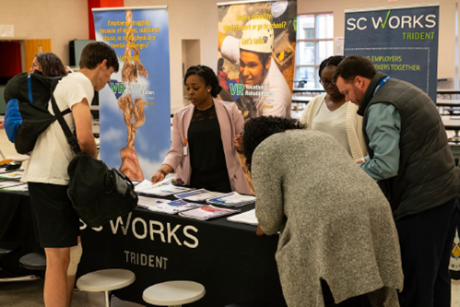
What services are available at the SC Works Center?
SC Works partner agencies can assist customers with finding new employment through career services such as:
Job Search Assistance
Resume Preparation Guidance
Interviewing Practice
Career Exploration
Basic Skills Remediation
GED Instruction
WorkKeys and WIN Preparation and Testing
Typing Tests
Access to Job Fairs and Hiring Events

Slide 7
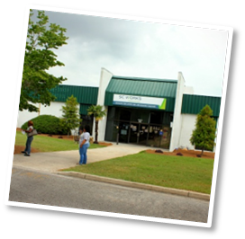
Locations
As part of the South Carolina Works system we offer a full array of re-employment services at each of our centers listed below:
SC Works Berkeley
305 Heatley Street
Moncks Corner, SC 29461
(843) 761-4400 TTY: 711
Office Hours: Monday-Friday 8:30am-5:30pm
SC Works Charleston
1930 Hanahan Road, Suite 200
North Charleston, SC 29406
(843) 574-1800 TTY: 711
Office Hours: Monday-Friday
8:30am-5:00pm
SC Works Dorchester
1325-A Boone Hill Road
Summerville, SC 29483
(843)821-0695 TTY: 711
Office Hours: Monday-Friday
8:30am-4:00pm

Slide 8
Partner Agency Services
South Carolina Department of Employment and Workforce (SC DEW)
  Basic Career Services such as Job Search and Resume Assistance
  Veteran Employment Services
Adult Education
  Basic Skills Remediation
  GED Instruction and Testing
  WorkKeys/WIN Instruction and Testing
  English as a Second Language Instruction
Military Community Connects (MCC)
  Homeless Veteran Reintegration Program
South Carolina Vocational Rehabilitation
  Job Placement and Training Services for individuals with disabilities

Slide 9
South Carolina Commission for the Blind
  prevention-of-blindness services to blind and visually impaired consumers leading to competitive employment.
Department of Social Services
  SNAP benefits
  Temporary Assistance for Needy Families (TANF)
Telamon
  Migrant and Seasonal Farm Worker Services
Trident Technical College
  Occupational Skills Training and Degree Programs
Palmetto Community Action Partnership
  Basic Needs and Emergency Assistance
Goodwill (SCSEP)
  Employment program for individuals 55 and older

Slide 10
What is the Workforce Innovation and Opportunity Act (WIOA) Program?
Who can benefit from WIOA services?
Youth Program
Youth ages 17-24 with barriers to employment
Adult Program
Adults 18 and over who are
Unemployed
Underemployed
Dislocated Workers
The Workforce Innovation & Opportunity Act (WIOA) is federally funded employment and training program that assist customers with developing workforce opportunities, accessing training, and career choices.

Slide 11
What does the WIOA program offer?
Individualized Career Services including resume assistance, interviewing skills, and job search support.
Training Services-Occupational Skills Training and On the Job Training in in-demand Career Pathways.
Supportive Services to assist with the cost of background checks, drug screens, and training materials. In some cases support may be available for transportation and child care.

Slide 12
Career Services
Basic Services Include
  Job Search Resources
  Job Fairs and Hiring Events
  Employability Skills Workshops
  Applicant Pre-Screening for Employers
Individualized Services Include
  WIOA Enrollment
  Individual Employment Plan Development
  Career Assessments
  Case Management Services to assist with individual employability skills development.

Slide 13

Training Services
Training Services Include
  Occupational Skills Training
  On the Job Training
  GED Preparation

Slide 14
How do I become enrolled in the WIOA program?
You must call your nearest SC Works center and make an eligibility appointment. A determination of eligibility is required by law and generally takes approximately one hour to complete. Once determined eligible, you may be enrolled in the WIOA program and received Individualized Career and Training Services.

